Slide 1

LIME ACCESS ONLINE PLATFORM FOR TRAINING OF PEOPLE ENTERING THE PWR
REGISTRATION FOR PEOPLE ENTERING
Appendix No. 6a
RTX Corporation (Corporate) - Company Use

Slide 2

Export control classification
DATE OF MARKING (YYYY-MM-DD) | 22.08.2025 | BADGE (XX-#####): | P536717
X
Check this box if the document contains „no technical data”
OR
Summarize the export classification of all slides
in this presentation as instructed below
Classification values must always be provided for U.S. and Outside U.S. boxes. When the person completing the grid is physically located outside of the U.S., the local classifications must also be provided. | CLASSIFICATION
 | LOCATION | U. S. REGULATION U.S.
 |  | EAR | ITAR
 | U.S.
 | OUTSIDE U.S.
 |  | LOCAL REGULATION
 | POLAND | PL / UE | DPA (CG)
 |  |  | Document may be DPA controlled if EIPA value starts with “2” or US ITAR box contains any value other than “NSR”.
P-ECCN
P-USML
ECCN
USML
For instructions and examples on how to fill in this slide, contact GT Focal
When you are located outside of Poland, modify the Local Regulation section accordingly
PROPRIETARY NOTICE
This document includes proprietary information of Pratt & Whitney Rzeszów S.A (P&W) You may not possess, use, copy or disclose this document or any information in it, for any purpose, including without limitation to design, manufacture, or repair parts, or obtain TCCA, FAA, or other government approval to do so, without prior written permission of the owner of proprietary information. Neither receipt nor possession of this document alone, from any source, constitutes such permission. In order to obtain permission to use the information, contact the person from whom you obtained the document. Possession, use, copying or disclosure by anyone without P&W’s express written permission is not authorized and may result in criminal or civil liability.
Export control classification: [NO TECHNICAL DATA]
DATE OF MARKING: [2025-08-22], BADGE [P536717]
FOR PLANNING PURPOSES ONLY
RTX Corporation (Corporate) - Company Use

Slide 3
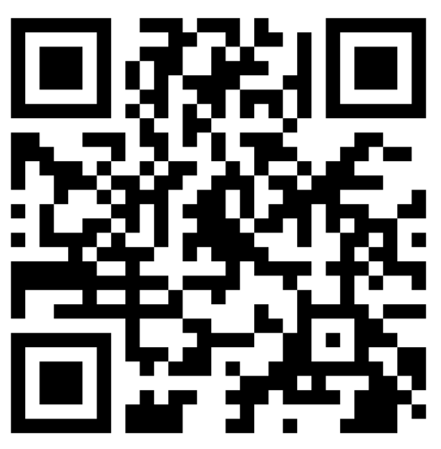
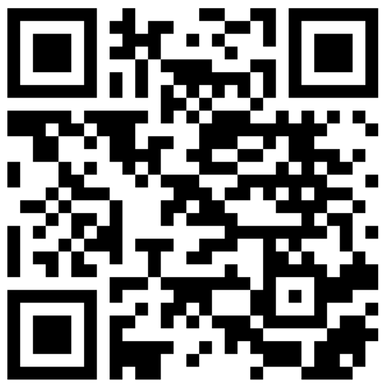
START
In the Chrome browser, run the link or use your mobile device to scan the QR code, which will directly redirect to the platform.
GUEST: https://t.s2.limeaccess.com/QQI2NY
CONTRACTOR: https://t.s2.limeaccess.com/J8I41Y
Please follow the instructions in the registration panel
RTX Corporation (Corporate) - Company Use

Slide 4

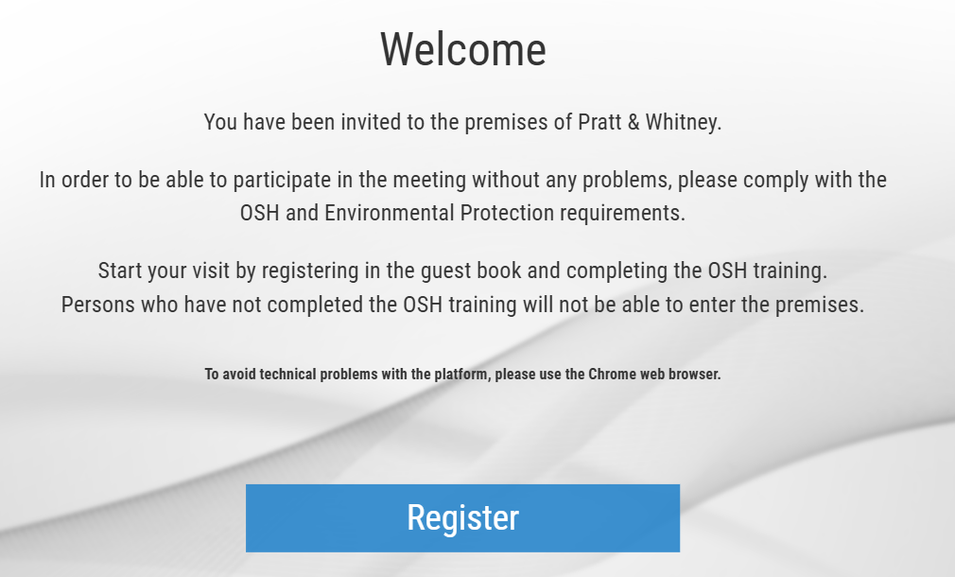
Registration Panel
Ability to change the language
First registration in the system
RTX Corporation (Corporate) - Company Use

Slide 5
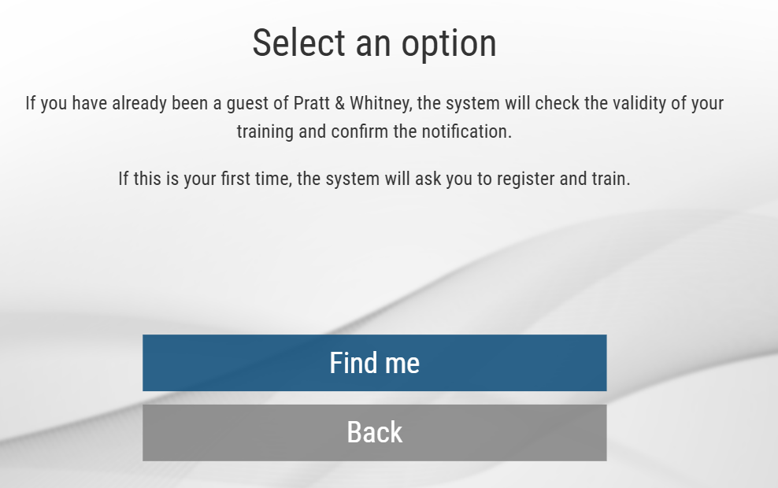
Registration Panel (verification)
Ability to change the language
Possibility to verify the validity of the training or to register those who will be the first time in PWR
RTX Corporation (Corporate) - Company Use

Slide 6
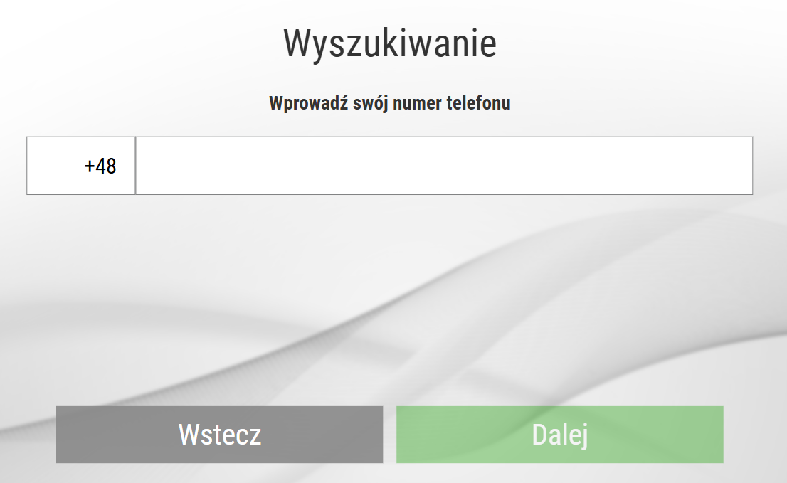
Registration Panel (verification)
Ability to change the language
Select your country code
To identify yourself, enter your phone number
RTX Corporation (Corporate) - Company Use

Slide 7
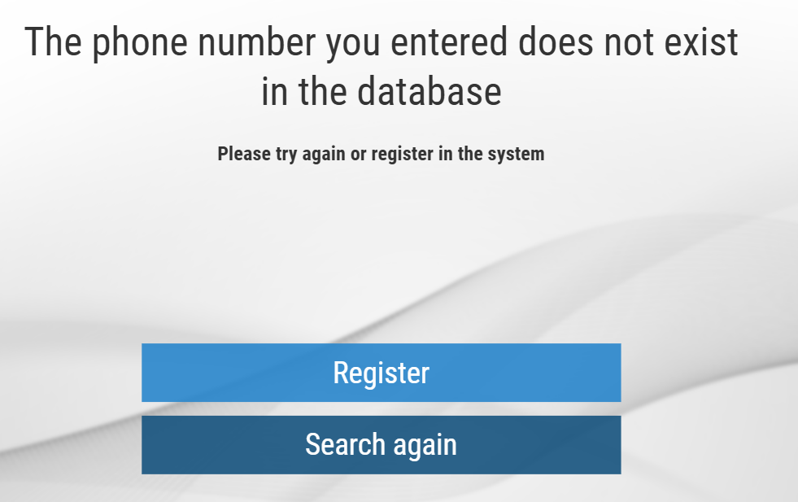
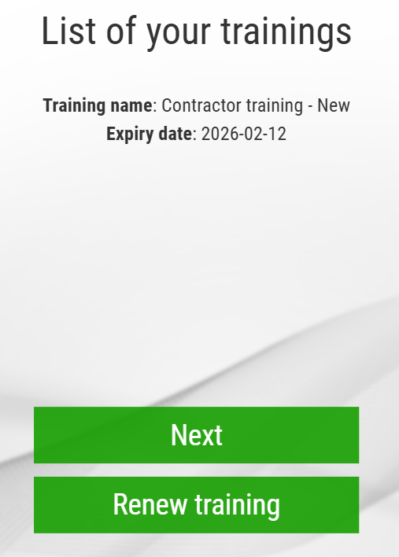
Registration Panel (training validity/renewal)
If the phone number provided exists in the database, information about the validity of the training will appear.
If the phone number provided does not exist in the database, you must register in the system.
It is possible to renew training courses.
RTX Corporation (Corporate) - Company Use

Slide 8
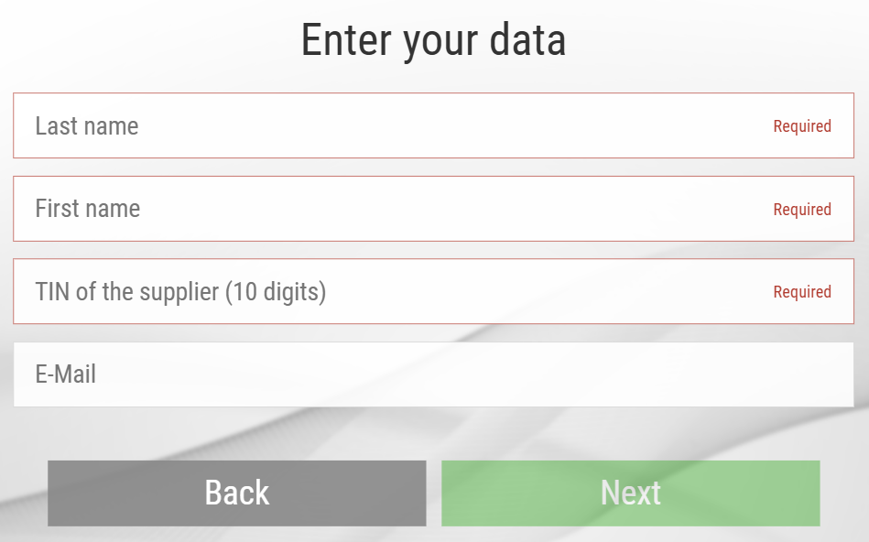
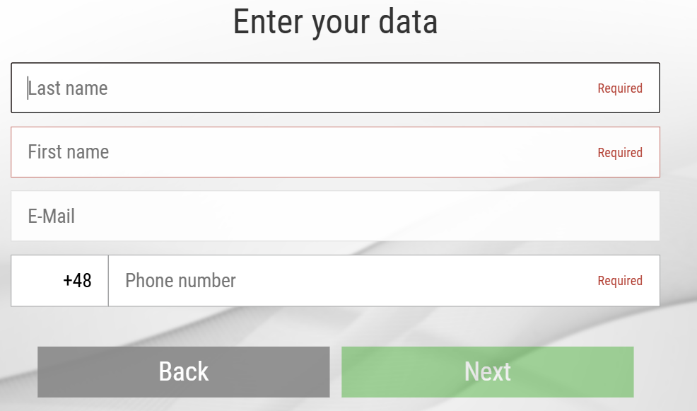
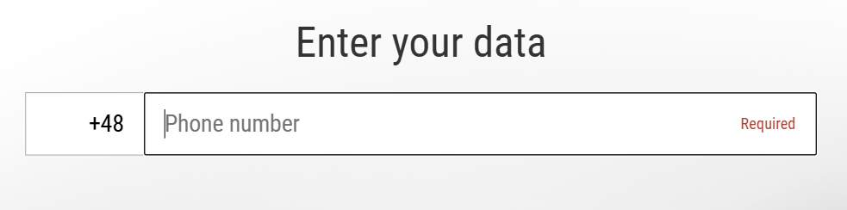
Registration Panel
Contractor:
Guest:
Select your country code
Enter the data required for registration
Select your country code
RTX Corporation (Corporate) - Company Use

Slide 9
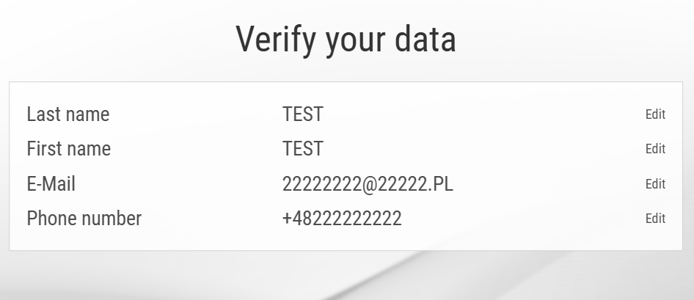
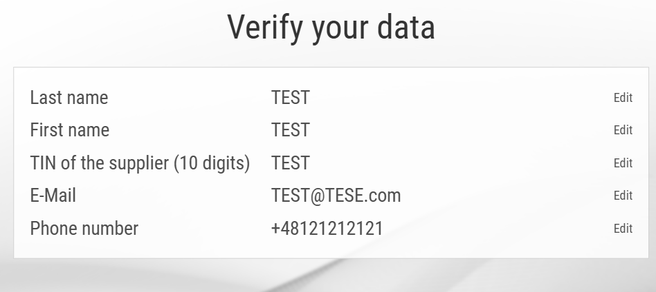
Registration Panel
Contractor:
Guest:
Please check if the data is correct, if not you can correct it using the Correct button, if the data is correct, please go Next
RTX Corporation (Corporate) - Company Use

Slide 10
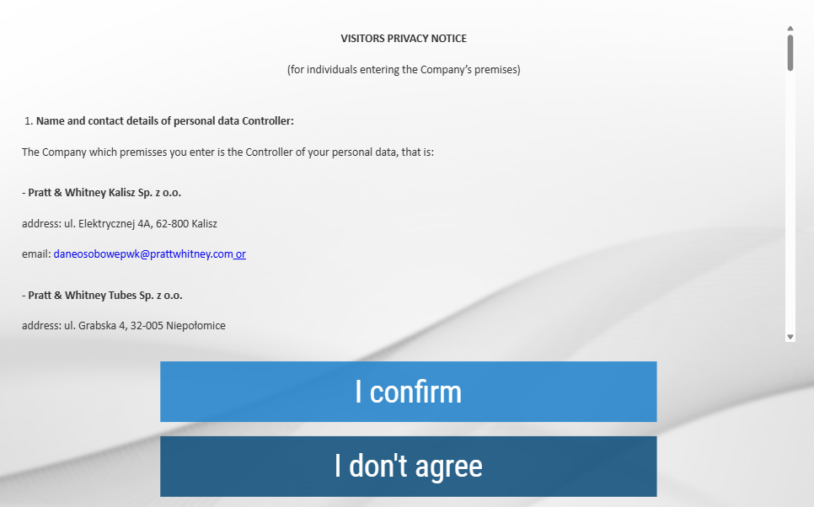
Registration Panel
Please read the information clause and confirm the fact with the Confirm button.
Cancel - Lack of consent to the processing of data results in the interruption of the registration process
RTX Corporation (Corporate) - Company Use

Slide 11

Registration Panel
Contractor/ Guest:
The registration process has been successfully completed, please go to the Health and Safety Training
RTX Corporation (Corporate) - Company Use

Slide 12


Registration Panel (training)
Contractor:
Guest:
Contractor/Guest health and safety training must be completed.
At the end of the training, there will be a test with questions (for contractors).
RTX Corporation (Corporate) - Company Use

Slide 13

Registration (completion)
Thank you for completing the training.
Please come to the Pass Office, where the data provided during registration will be verified. Only after successful verification will it be possible to obtain a pass and enter the company premise.
RTX Corporation (Corporate) - Company Use

